Slide 1


Presented By
Aashish Rijal - 79010939
Kedar Dhungana - 79010957
Dipesh Devkota - 79010952
PROJECT PROPOSAL
Futsal Booking and Management System
Under the Supervision of
Mr. Surya Bam
Institution
Asian School of Management and Technology
B.Sc. CSIT | Tribhuvan University
February 25, 2026

Slide 2
Overview
Introduction and Background
Problem Statement
Literature Review
Development Methodology
Functional Requirements
Non-Functional Requirements
Schedule Feasibility
Technical Feasibility
Algorithms Description
Flow Chart
Expected Outcomes
References

Slide 3
Introduction & Background
Current Landscape
Proposed Solution
Futsal Growth in Nepal
Multi-Tenant SaaS Platform
Rapid increase in urban futsal centers due to rising interest in indoor football and recreation. [1]
Centralized web-based system allowing multiple businesses to operate independently on shared infrastructure.
Manual Dependency
Smart Innovation
Most facilities rely on phone calls, social media, or paper registers for bookings.
Integration of ML for automated Sentiment Analysis

Slide 4



Problem Statement
Many futsal centers still use manual systems, which cause slow operations, booking mistakes, poor customer experience, and no proper business data insights.
Operational Chaos
Discovery Barriers
Business Intelligence Gap
Manual bookings via phone/social media cause double bookings, scheduling conflicts, and inaccurate record-keeping.
No centralized platform for players to discover and compare multiple courts, prices, and reviews.
Futsal owners lack proper data and smart tools, making it hard to track profits, popular times, customer satisfaction, or use AI insights

Slide 5




Project Objectives
Centralized Platform
Multi-Tenant SaaS
Community Features
AI/ML Integration
To develop a unified web portal for real-time discovery and court booking, ensuring accessibility for all users.
To implement a scalable architecture allowing multiple futsal facilities to operate independently within one system.
To enable verified ratings, reviews, and discussion forums to enhance user interaction and trust.
To integrate sentiment analysis for smarter business decision-making.

Slide 6




Literature Review
Suhaimi & Sahid (2021)
Research highlights the necessity of replacing manual logbooks with database-driven platforms to improve booking visibility and scheduling clarity.[1]
Fauzi et al. (2022)
Web-based systems significantly increase accessibility and customer reach while reducing the risks associated with handwritten rental processes. [4]
Modern System Design
Multi-tenant SaaS architecture is recommended for shared platforms to ensure proper data isolation and scalability for independent facility owners. [6]
Machine Learning Trends
Increasing application of Logistic Regression and TF-IDF for sentiment analysis and text feature extraction in user engagement platforms. [2][7]

Slide 7
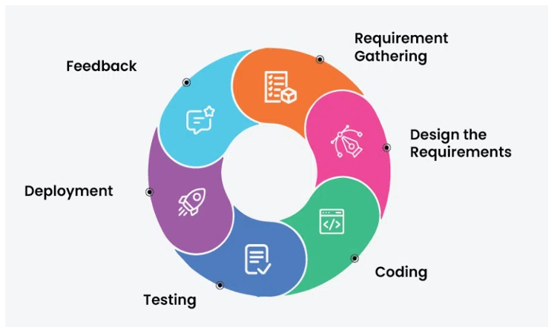
Development Methodology
The project uses the Agile Development Model, which focuses on making progress step by step, getting regular feedback, and easily adjusting to changing needs.
Fig: Agile Development Model [3]

Slide 8




Functional Requirements
End User
Futsal Owner
System Admin

Search futsal centers by location, price, and slots

Manage futsal profile and Court availability.
.

Manage all multi-tenant accounts.
.
.

Set dynamic pricing and time slot configurations.

Monitor system-wide usage and generate reports.

Real-time court booking and instant confirmation.

Approve/Manage booking requests and schedules.

Monitor system-wide usage and package tiers..
.

Submit verified ratings and reviews.

Moderate user accounts and content.

Respond to customer queries and reviews.

Personalized recommendations based on proximity.
System-level configuration and maintenance.


Manage booking history and profile settings.

Slide 9
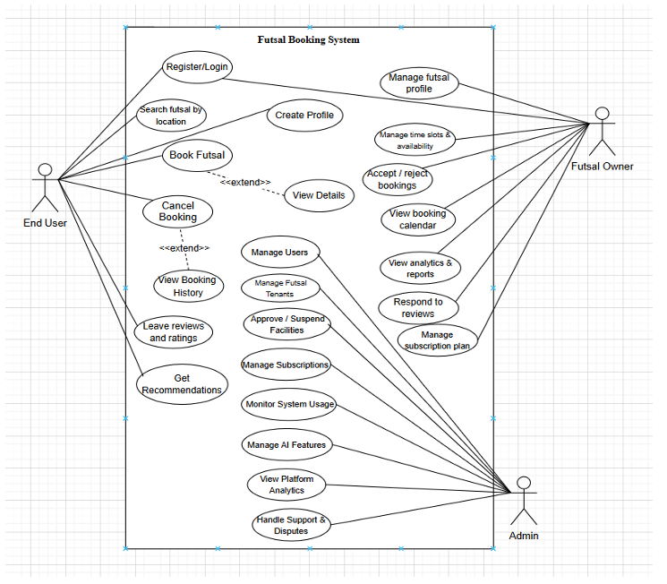
Use Case
Futsal Booking & Management System

Slide 10




Non-Functional Requirements
Performance
Scalability
Ensuring real-time availability checks and high-speed response times for booking confirmations and slot validations.
A scalable multi-tenant architecture designed to handle a growing number of futsal centers and concurrent users seamlessly.
Security
Usability
Implementation of JWT authentication and strict data isolation between tenants to ensure privacy and data integrity.
A mobile-responsive design ensuring a consistent and intuitive user experience across all devices and screen sizes.

Slide 11
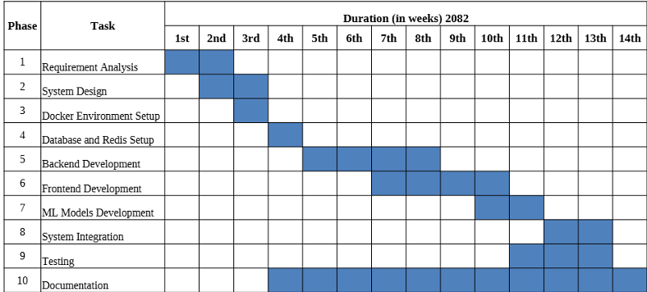
Schedule Feasibility

Slide 12





Technical Feasibility
Frontend
Backend
Data Layer
AI & ML

React.js
for dynamic UI

Node.js & Express

MySQL
for persistence

Python
NLP libraries

Responsive design for mobile

Scalable RESTful API design

Redis
for slot caching

Logistic Regression model

Multi-tenant data isolation

Cloud-based file storage

TF-IDF text processing

JWT-based session handling

Slide 13



Algorithms Description
Slot Conflict Preventation
Location Distance (Haversine Formula)
Logistic Regression
The algorithm checks existing bookings for the selected court & date.
For a new booking request with start time S and end time E, the system verifies overlap
with existing slots (Sᵢ, Eᵢ).
→ If overlap exists → Booking is rejected.
→ If no overlap → Booking is confirmed and slot is locked.
Mathematical Logic:
Two slots overlap if: (S < Eᵢ) AND (E > S).
Booking is allowed only if:
∀i: NOT[(S< Eᵢ) AND (E> Sᵢ)]
This guarantees that only one active booking exists per court per time range
The algorithm reads user latitude and longitude. It compares them with futsal center coordinates. Distances are calculated and sorted ascending. Nearest futsal centers are recommended first.
Mathematical Logic:
d = 2r × arcsin( √( sin²(Δφ/2) + cos(φ₁) × cos(φ₂) × sin²(Δλ/2) ) ) Where: d = distance between two points r = Earth radius (6371 km) φ = latitude, λ = longitude (in radians) Δφ = φ₂ − φ₁ Δλ = λ₂ − λ₁
TF-IDF feature vectors are generated from reviews. These features are passed into the logistic regression model. The model computes probability scores.
A threshold (usually 0.5) is used to assign class labels.
→ Probability ≥ threshold → Positive sentiment
→ Probability < threshold → Negative sentiment
Mathematical Logic:
p = 1 / (1 + e^(−z))
Where:
z = w₀ + w₁x₁ + w₂x₂ + … + w ₙxₙ
Decision rule:
Class = 1 if p ≥ 0.5
Class = 0 if p < 0.5
Logistic Regression + TF-IDF for review categorization
(Positive/Negative).
futsal courts.

Slide 14
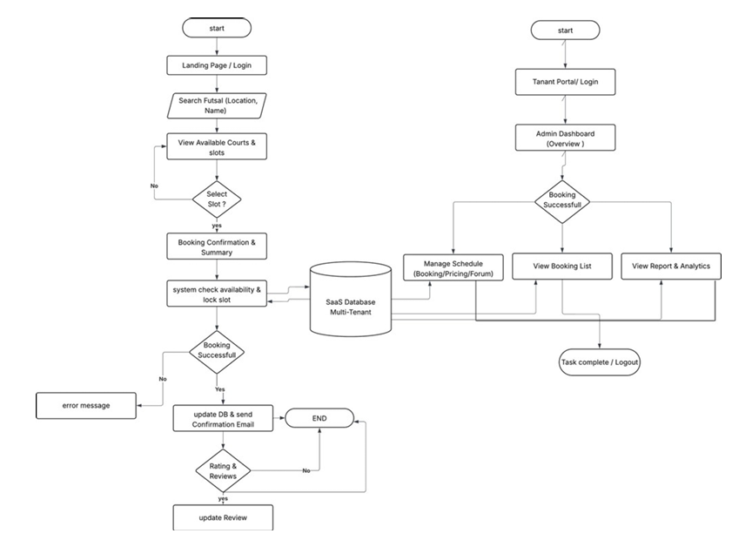
Flow Chart
Futsal Booking & Management System

Slide 15




Expected Outcomes
Operational Efficiency
Enhanced Experience
Scalable Innovation

Elimination of double bookings and manual scheduling errors.

One-stop platform for real-time discovery and court comparison

Robust multi-tenant SaaS model ready for commercial expansion.

Automated revenue tracking and business intelligence reports.

Convenient booking process with instant mobile confirmations.

AI-driven insights through sentiment analysis of user feedback.

Streamlined customer communication and subscription management.

Access to verified reviews and proximity-based recommendations.

Secure, high-performance infrastructure for nationwide futsal management.
.

Slide 16

References
[1] A. N. S. Suhaimi and M. Z. Sahid, "A Development of Futsal Court Booking System," AITCS, vol. 4, no. 1, 2023.
[2] Coursera, "What is TF-IDF?" [Online]. Available: https://www.coursera.org/articles/what-is-tfidf
[3] GeeksforGeeks, "Agile SDLC" [Online]. Available: https://www.geeksforgeeks.org/agile-sdlc-software-development-life-cycle/
[4] A. Fauzi et al., "Explore Business Opportunities in the Sport Industry in Bekasi," IJESM, vol. 1, no. 2, 2023.
[5] SportsKey, "Sports Facility Booking Software Trends," 2026. Available: https://www.sportskey.com
[6] UiTM, "Progressive Web Applications for Mobile-First Systems," 2024.
[7] S. Nagar et al., "Logistic Regression Based Approach for Human Sentiment Analysis," ACROSET, 2024.
[8] IBM, "What is multi-tenant architecture?" Available: https://www.ibm.com/think/topics/multi-tenant

Slide 17
QUESTIONS?
Project Team
Aashish Rijal
Kedar Dhungana
Thank You!
Dipesh Devkota
Futsal Booking and Management System
Supervisor
Mr. Surya Bam

